Slide 1


Department of BES-I
COURSE: Data Structures using Python
COURSE CODE: 24SC1204
Topic:
Name of the topic:
double hashing
Rehashing
Session – 22

Slide 2



AIM OF THE SESSION
To familiarize students with the basic concept of Double Hashing, Extendible hashing, Rehashing
INSTRUCTIONAL OBJECTIVES
This Session is designed to:
Demonstrate Double Hashing, Extendible hashing, Rehashing
List out the advantages and applications of hashing techniques.
LEARNING OUTCOMES
At the end of this session, you should be able to:
Define Double Hashing, Extendible hashing, Rehashing.
Describe each method.
Summarize definition, types of hashing and its applications

Slide 3
Double Hashing
Double hashing
Double hashing is a collision resolution technique that utilizes two hash functions to handle collisions when multiple keys map to the same index in a hash table.
First hash function is typically hash1(key) = key % TABLE_SIZE
Whenever collision occurs, second hash function is
hash2(key) = PRIME – (key % PRIME)
where PRIME is a prime smaller than the TABLE_SIZE.
Then calculate h(key, i ) = (hash1(key) + i * hash2(key)) % tableSize
Where, i is the probe count, starting from 1 and incrementing for each failed attempt.

Slide 4
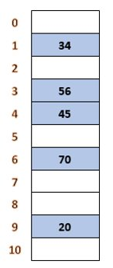
Double Hashing
Example:Consider a sequence of keys as 20, 34, 45, 70, 56 with table_size 11
h₁(20) = 20 mod 11=9
h₁(34) = 34 mod 11=1
h₁(45) = 45 mod 11=1
Collision Occurs at index 1, so calculate second hash function
h₂(45) = 8 - (45 mod 8) = 3
Now, calculate h(45, 1) = (1 + 1 * 3) mod 11=4, where i=1
h₁(70) = 70 mod 11=4
Collision Occurs at index 4, so calculate second hash function
h2(70) = 8 - (70 mod 8) = 2
h(70, 1) = (4 + 1 * 2) mod 11=6
h1(56) = 56 mod 11=1
Collision Occurs at index 1, so calculate second hash function
h2(56) = 8 - (56 mod 8) = 8
h(56, 1) = (1 + 1 * 8) mod 11=9, where i=1
Again, Collision Occurs, increment i, h(56, 2) = (1 + 2 * 8) mod 11=6, where i=2
Again, Collision Occurs, increment i, h(56, 3) = (1 + 3 * 8) mod 11=3, where i=3

Slide 5
Rehashing
Rehashing:
Rehashing method is used to prevent collisions by increasing the size of a hashmap and redistributing the elements into new buckets based on their new hash values.
How Rehashing is done?
For each new entry to the map, check the load factor.
If it’s greater than its pre-defined value (or default value of 0.75 if not given), then Rehash.
For Rehash, make a new array of double the previous size and make it the new bucket array.
Then traverse to each element in the old bucket Array and call the insert() for each so, as to insert it into the new larger bucket array.

Slide 6
Load Factor Calculation
Load factor can be calculated by using the following formula:
The initial capacity of the HashMap * Load factor of the HashMap.
Good load factor value is 75, while HashMap's default beginning capacity is 16, when the number of elements hits or exceeds 0.75 times the capacity, the complexity rises.
To combat this, the array's size is doubled, and all the values are hashed again and saved in the new double-sized array.
After Rehashing items can fall into same bucket or different bucket into new array.
Ex: when the number of items reaches 12, rehashing begins. (as 12 = 0.75 * 16).

Slide 7
IMPORTANT FACTS RELATED TO THE SESSION
Advantages of Double hashing
It can reduce clustering by using a second hash function to determine the next probe location.
It can handle a larger number of collisions than linear probing.
Disadvantages of Double hashing
It can be more complex to implement and understand than linear or quadratic probing
Advantages of Rehashing
Handling collisions: As mentioned above, rehashing is primarily used to handle collisions in hash tables. ...
Improving performance: Rehashing can also be used to improve the performance of hash
tables
Advantages of Extendible Hashing
Data retrieval is less expensive (in terms of computing).
Very flexible in choosing size of bucket and alllows storage on disks/remote memory access.
Disadvantages of Extendible Hashing
Increased algorithm complexity
Extra memory overhead to store index inside the bucket.

Slide 8
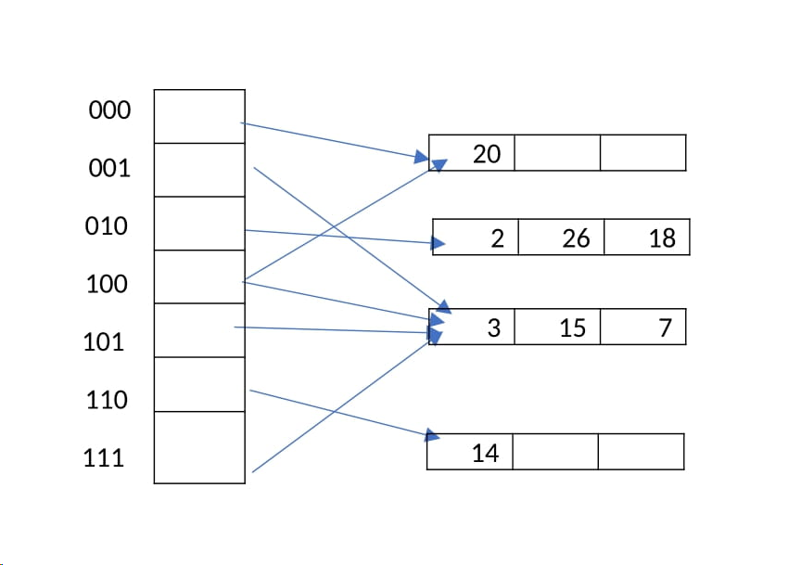
EXAMPLES
Consider an extendible hashing structure that, each bucket can hold up to 2 records. Is initially empty (only one empty bucket). Consider the result after inserting keys 8, 16, 4, 3, 11, 12 in order, using the lowest bits for the hash function. That is records in a bucket of local depth d agree on their rightmost d bits. For example, key 4 (0100) and key 12(1100) agree on their rightmost 3 bits (100). What is the global depth of the resulting directory? Now insert key 18. What is the local depth of the bucket that contains key 18?

Slide 9
IMPORTANT FACTS RELATED TO THE SESSION
Applications of rehashing in real life
Password Verification
Data Structures
File System.
Applications of Extendible Hashing
All modern file systems use extendible hashing.
Applications of Double Hashing
To prevent the collision of two keys ,the idea of Double Hashing is used. In case any collision occurs when we just use traditional hash code evaluating function, another hash code is generated by some other function and both the hash codes are used to find a free space by probing through array elements.

Slide 10
SUMMARY
Double hashing:It is a technique in which two hash function are used when there is an occurrence of collision.
The hash functions for this technique are:
H1(key)= (key % table size + i * H2(key))% table size
Whereas H2(key)=P-(key mod P); i=0,1..<size
Rehashing is the process of increasing the size of a hashmap and redistributing the elements to new buckets based on their new hash values. It is done to improve the performance of the hashmap and to prevent collisions caused by a high load factor.
Extendible Hashing is a dynamic hashing method wherein directories, and buckets are used to hash data. It is an aggressively flexible method in which the hash function also experiences dynamic changes.
Number of Directories = 2^Global Depth.

Slide 11
SELF-ASSESSMENT QUESTIONS
1. What is the hash function used in Double Hashing?
a) (h1(k) – i*h2(k))mod m
b) h1(k) + h2(k)
c) (h1(k) + i*h2(k))mod m
d) (h1(k) + h2(k))mod m
2. Double hashing is one of the best methods available for open addressing
a) True
b) Falseny point

Slide 12
TERMINAL QUESTIONS
1. What is Load factor?
2. When is rehashing done?
3. What is local depth, global depth?

Slide 13
REFERENCES FOR FURTHER LEARNING OF THE SESSION
Reference Books
Data Structures and Algorithm Analysis in PYTHON, 2010, Mark Allen Weiss, Second Edition, Pearson Education.
Data Structures and Algorithms, A.V.Aho, J.E.Hopcroft, and J.D.Ullman, Pearson Education, First Edition Reprint2003.
Advanced Guide to Python 3 Programming, John Hunt, 4th Edition, Springer Nature Switzerland AG 2019.
Python Basics: A Practice Introduction to Python 3, David Amos, Dan Bader, Joanna Jablonski, Fletcher Heisler, 4th edition, Real Python
.Sites and Web links:
https://docs.python.org/3/tutorial/datastructures.html
https://www.w3schools.com/dsa/dsa_intro.php
3. https://www.geeksforgeeks.org/python-data-structures/

Slide 14
THANK YOU
Team – Data Structures using Python

